Slide 1
Fluorescence Data Analysis
10u-5u-1u-500n-100n-50n chips
Lucky Jordan

Slide 2
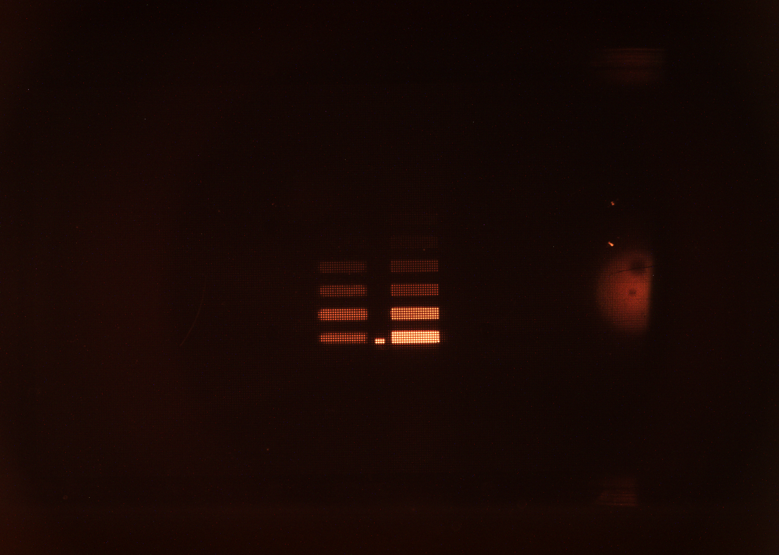
10u-5u-1u-500n-100n-50n chip

